Slide 1
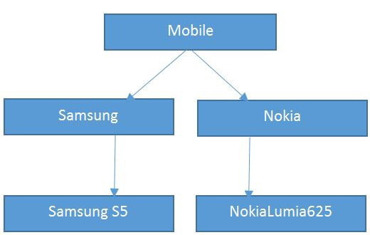
Inheritance
Presentation by Rohit Aditya Sahoo

Slide 2
Overview of Inheritance in JAVA
A mechanism in which one object acquires all the properties and behaviors of a parent object.
Inheritance represents the IS-A relationship which is also known as a parent-child relationship.
Super Class: The class whose features are inherited is known as super class.
Sub Class: The class that inherits the other class is known as sub class.

Slide 3
Why Inheritance ?
Vehicle
Bike
Car
Truck
Allows us to carry the features
The aim of inheritance is to provide the reusability of code of the parent class to the subclasses.
A developer will create a class only to write the unique features and rest of the common properties and functionalities can be extended from the another class.

